Slide 1
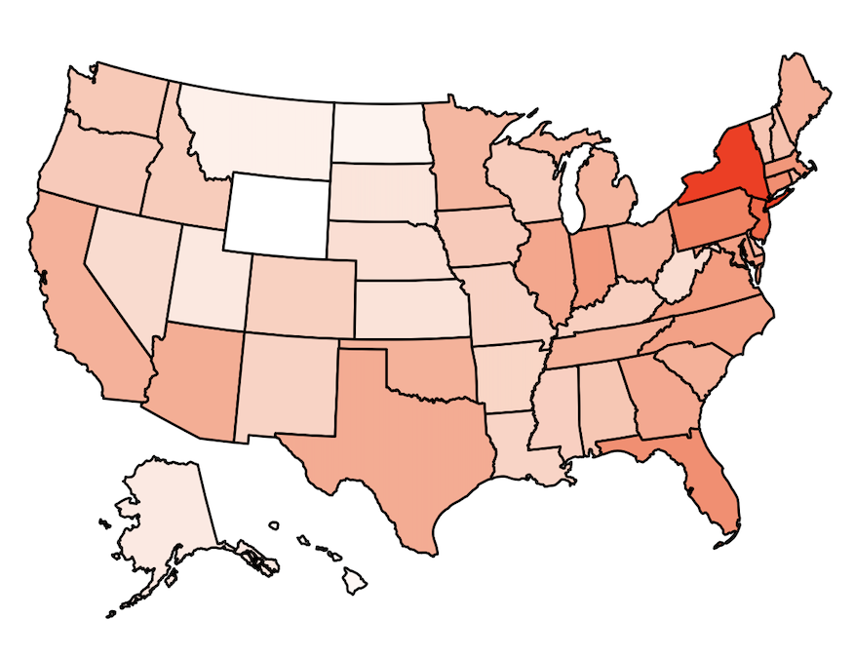
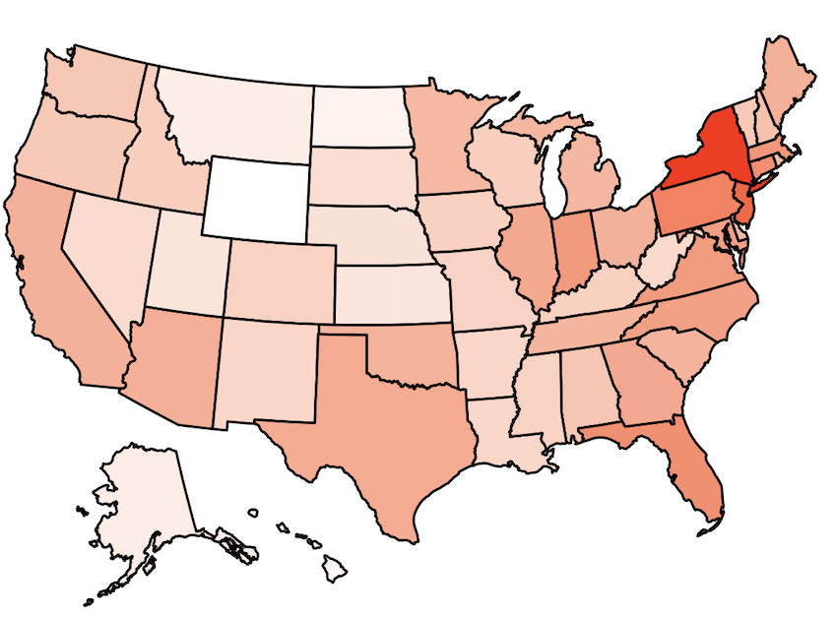
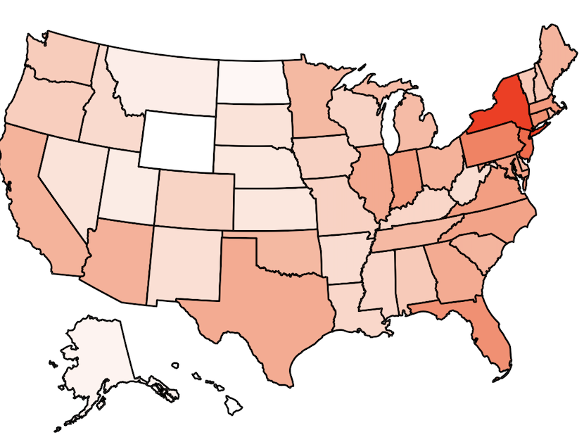
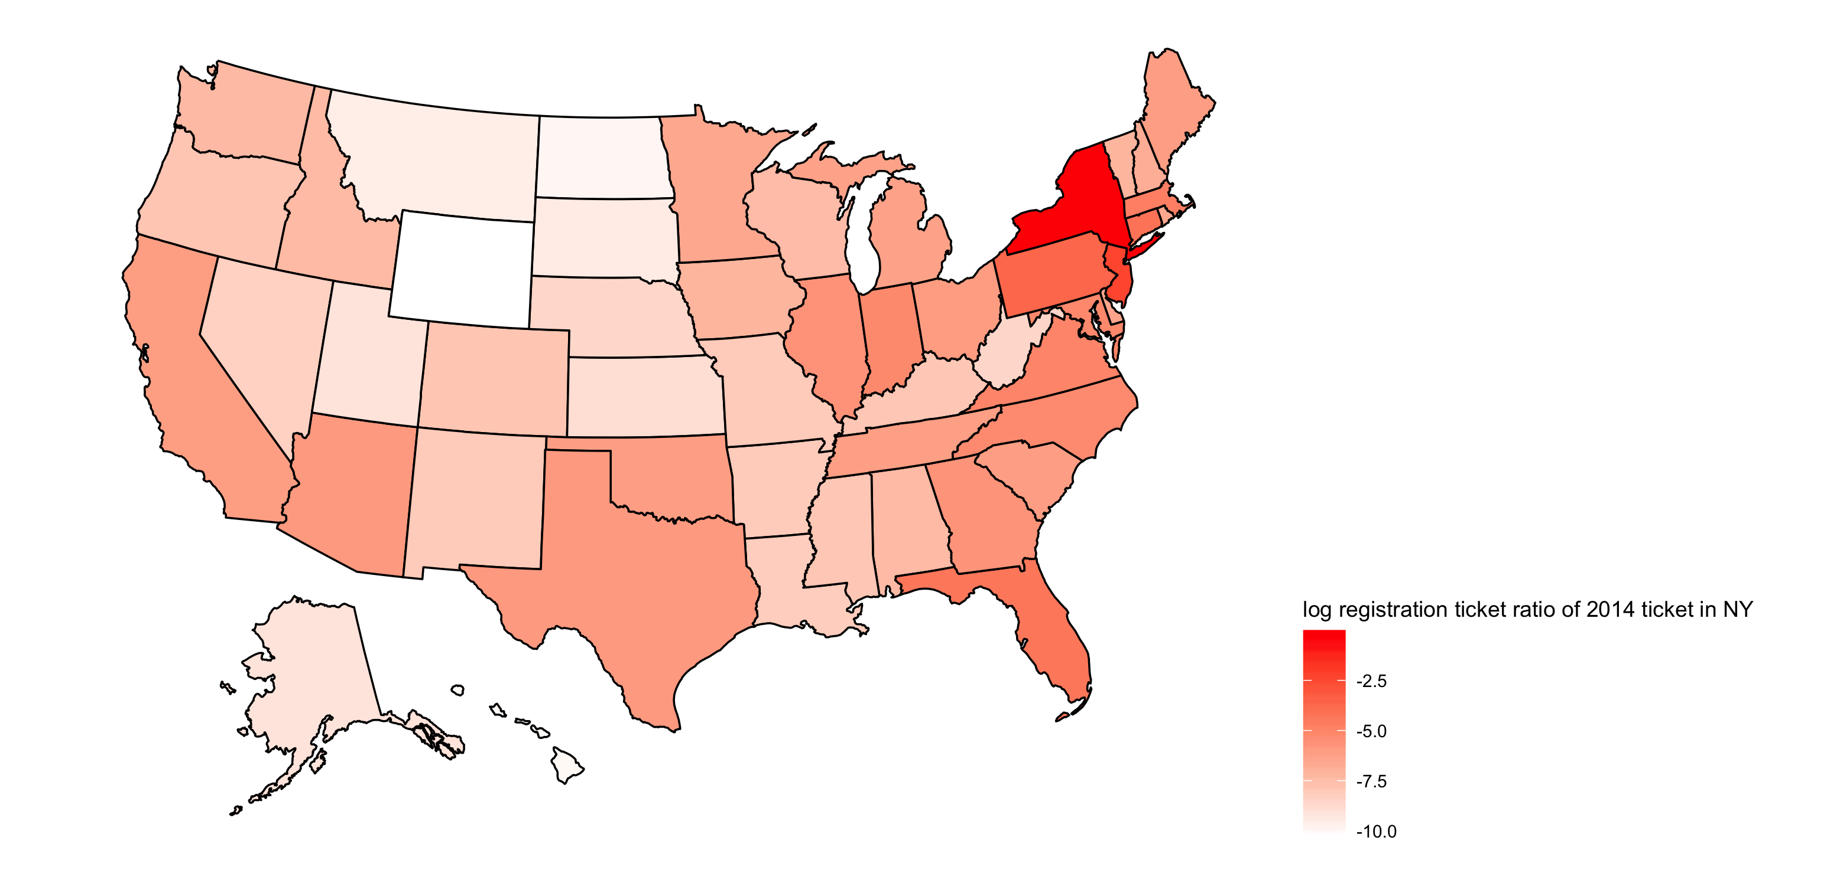
2015 2016 2017
Ratio of ticket vehicle registration states
NY: 77.7%
NJ: 9.7%
PA: 2.5%
……
WY: 0.00003
2014

Slide 2
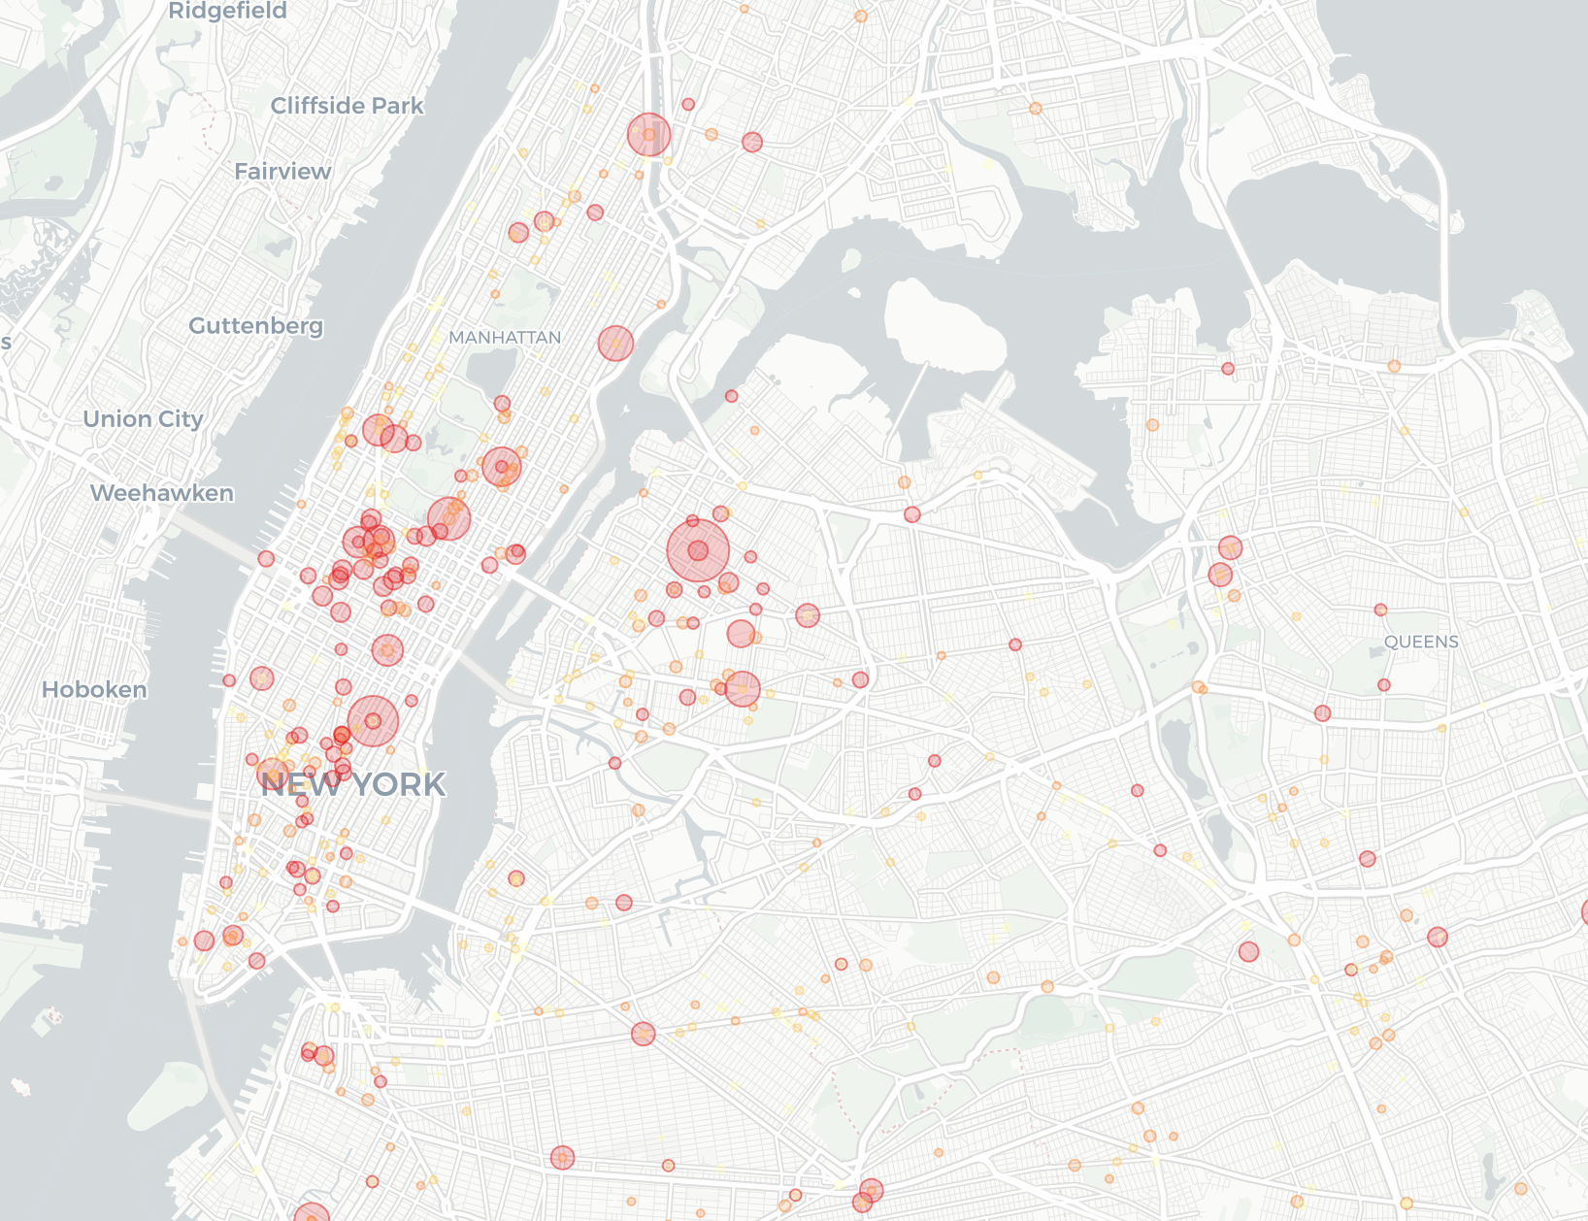
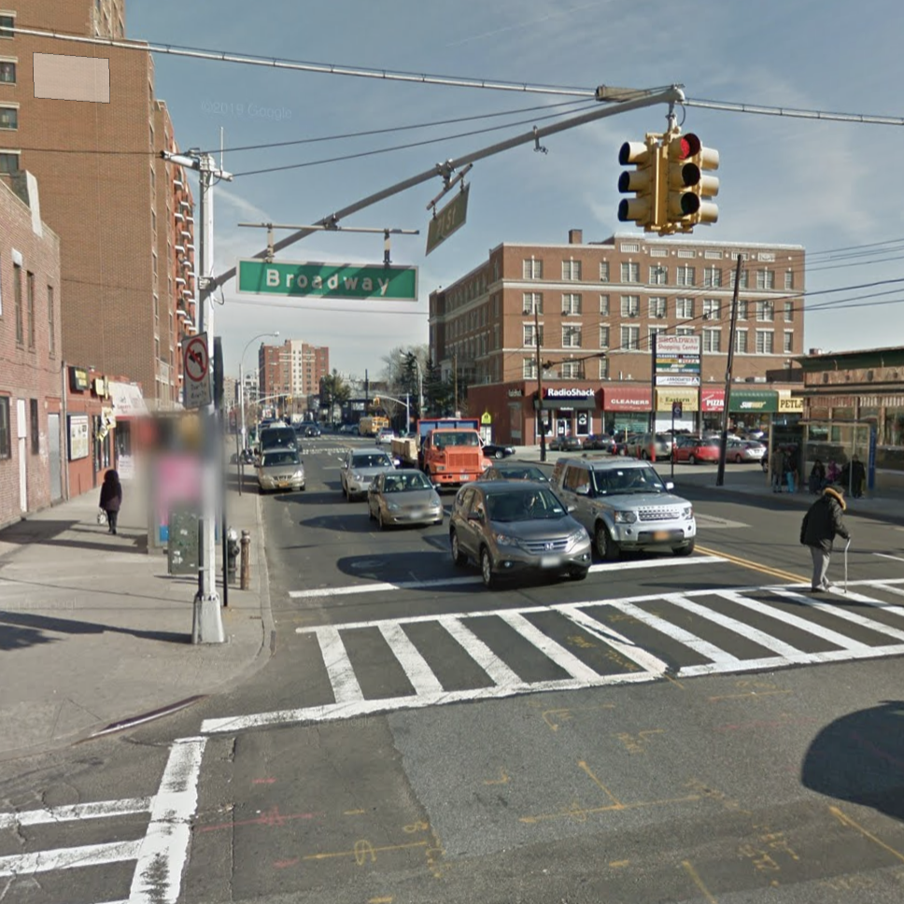
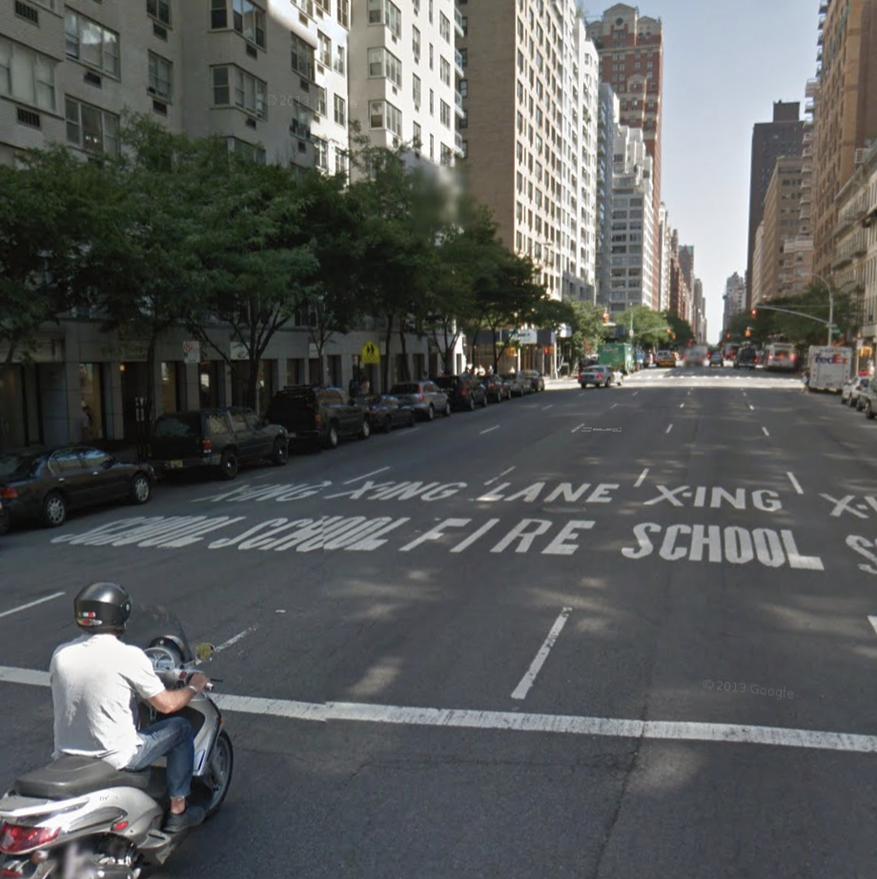
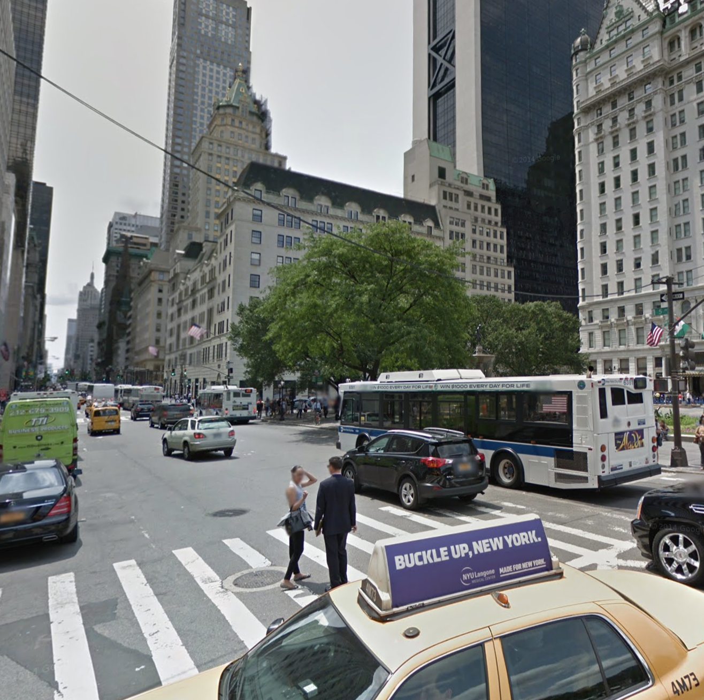
2014
Top 1: Broadway
201980
Top 2: 3rd AVE
148186
Top 3: 5AVE
97622

